Slide 1

Speaker Recognition
Current Status: Baselines
Vamsi Potluru, Rick Ruiz, Gene Chipman
August 2015

Slide 2
Quick Recap
Using voice biometrics to create and activate TV profiles. Easily.
Enable personalized features: Home startup screen, best channel on startup, personalized search results, recommendations, last 9, favorites, UI customization, social media profiles, parental controls
Enable authenticated features: Home security, financial transactions
Profile types: Implicit/passive vs. Explicit/interactive
Challenges of biometrics: Accuracy depends on duration and quality of speech sample, unstructured speech requires up to 1 minute of speech.

Slide 3
Research Steps
Completed
Pull existing VREX data for “known” users
Experiment with clustering accuracy
Ongoing
Experiment with Nuance free speech training
Compare clustering versus Nuance for implicit case
Future
Experiment with customer service voice call logs.
Add VREX metadata to clustering.
Build profile creation UX for explicit case. Adjust algorithms and thresholds for both cases.
Report on data requirements and accuracy for both cases.

Slide 4
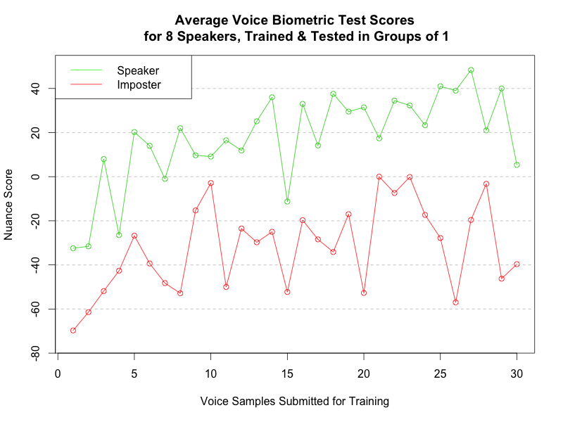
Nuance Baseline Behavior: Groups of One Speaker

Slide 5
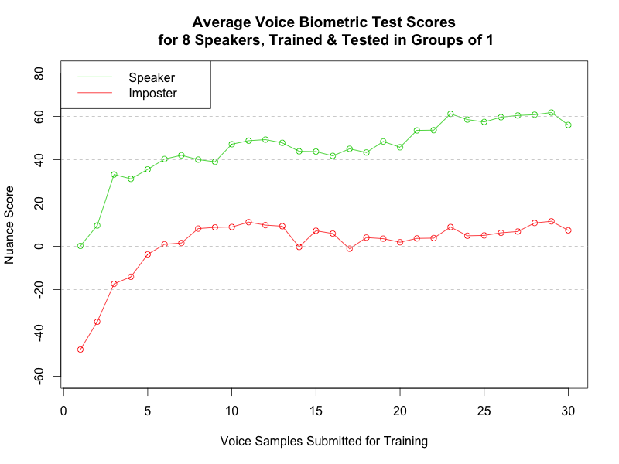
Nuance Baseline Behavior: Groups of One Speaker, Take II

Slide 6
Groups of 3 Users: Nuance (one case of 20)
 | Errinn | Novella | Gabrielle
Errinn | 326 | 11 | 8
Novella | 3 | 241 | 4
Gabrielle | 195 | 9 | 433

Slide 7
Groups of 3 Users: Clustering Software (one case of 20)
 | Errinn | Novella | Gabrielle
Errinn | 281 | 239 | 63
Novella | 3 | 1 | 287
Gabrielle | 64 | 8 | 344

Slide 8
Groups of 3 Users: Clustering Feeds Nuance (INCONCLUSIVE)
 | Errinn | Novella | Gabrielle
Errinn | N | n | n
Novella | n | N | n
Gabrielle | n | n | N

